Slide 1

MLSA KIET Internship
This project focuses on creating web applications using HTML, CSS, and JavaScript. It aims to build a simple personal webpage and a functional calculator.
Notes:
1

Slide 2

Creating a Simple Personal Webpage
HTML Structure
CSS Styling
The foundation of the webpage, defining the content and layout using tags like <h1>, <p>, <img>, and <a>.
Adding visual appeal with styles such as fonts, colors, spacing, and positioning. The style sheet controls how elements appear.
Notes:
2

Slide 3
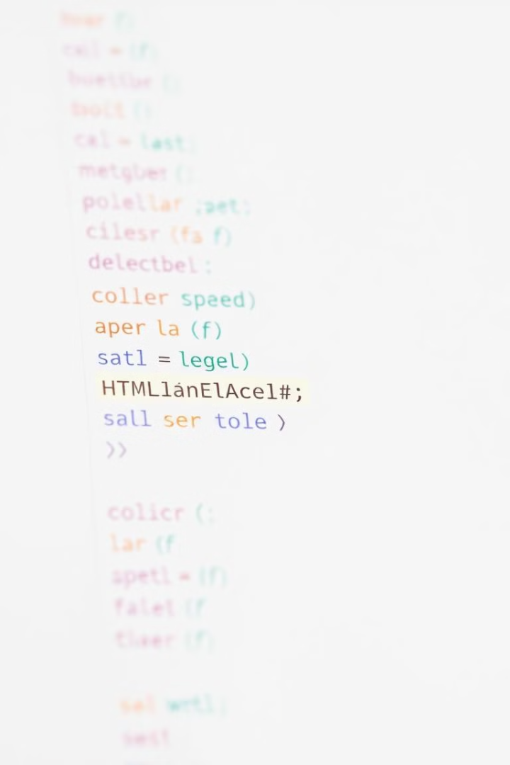
How to Create a Simple Personal Webpage
1
Structure Setup
Create an HTML file with basic structure, including <head> for metadata and <body> for content.
2
Content Addition
Add text, images, and links using appropriate HTML tags. Organize content into sections and paragraphs.
3
Styling with CSS
Create a separate CSS file and link it to the HTML. Use CSS rules to style elements and create a visually appealing design.
Notes:
3

Slide 4

How to Create a Simple Personal Webpage
1
Choose a Theme
2
Optimize for Readability
Decide on a color scheme, font style, and overall aesthetic that reflects your personality and preferences.
Use clear and concise text, appropriate headings, and white space for easy reading and navigation.
3
Responsive Design
Ensure the webpage looks good and functions correctly on different screen sizes, using responsive design techniques.
Notes:
4

Slide 5
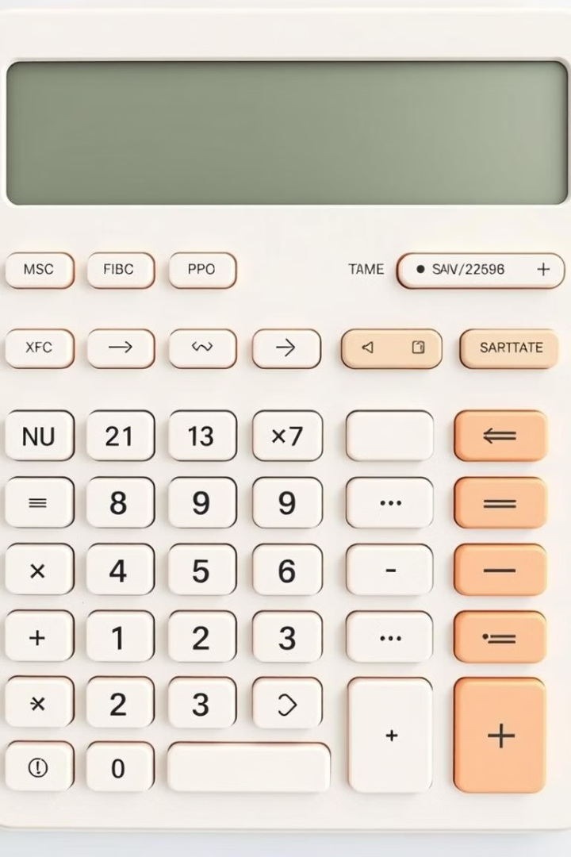
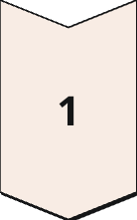
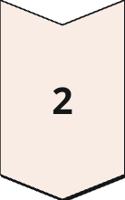
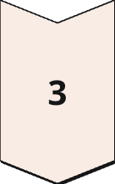
Creating a Simple Calculator
HTML Structure
Create a basic HTML structure with input fields for numbers and operators, and buttons for calculations.
CSS Styling
Style the calculator elements to create a user-friendly interface, including button appearance, layout, and colors.
JavaScript Logic
Add JavaScript code to handle user input, perform calculations, and display results dynamically on the page.
Notes:
5

Slide 6
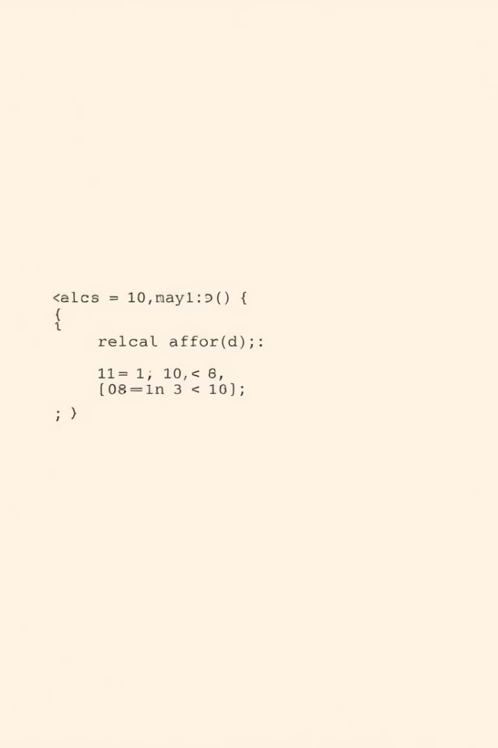
How to Create a Simple Calculator
Step
Description
1
Create input fields for numbers and operators.
2
Add buttons for numbers, operators, and the equals button.
3
Use JavaScript to handle user input and store the numbers and operators in variables.
4
Write JavaScript code to perform the calculation based on the selected operator.
5
Display the result of the calculation in an output field.
Notes:
6

Slide 7
How to Create a Simple Calculator
Input Handling
Calculation Logic
Result Display
Use JavaScript event listeners to capture user input from buttons and input fields.
Implement functions to perform basic arithmetic operations such as addition, subtraction, multiplication, and division.
Update the output field with the result of the calculation after the equals button is clicked.
Update the display dynamically as the user enters numbers and operators.
Consider clearing the display or updating the previous result based on user interaction.
Handle edge cases such as division by zero or invalid input.
Notes:
7

Slide 8
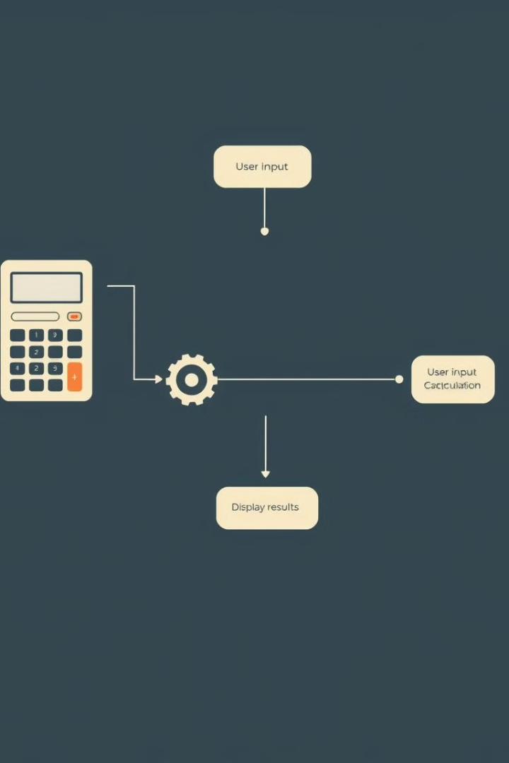




How to Create a Simple Calculator
Addition
Subtraction
Add two numbers together: `result = num1 + num2`.
Subtract the second number from the first: `result = num1 - num2`.
Multiplication
Division
Multiply the two numbers: `result = num1 * num2`.
Divide the first number by the second: `result = num1 / num2`.
Notes:
8

Slide 9
CREATED BY ANUSHK KUMAR RAJ, CSE BRANCH 2ND YEAR
This project is a part of the MLSA KIET Internship program. The aim was to create a simple webpage and calculator to showcase basic web development skills.
Notes:
9

Slide 10

Thank You
Thank you for viewing this presentation. You can find more about me and my work on my social media profiles.
Notes:
10

